Slide 1
Summer Research Fellowship Program (2019)
Indian Institute of Technology, Madras
Spatial Analysis of a Virtual Reality Scene
Computational Imaging Lab
Dept. Electrical Engineering
Nithin Philip Joseph
College of Engineering Trivandrum
EE19SFP0450

Slide 2
Content
Acknowledgement
Motivation
Abstract
Theory
Challenges
Solution
Demo
Shortcomings
Frequency Analysis
Conclusion

Slide 3
Acknowledgement
The success and final outcome of this project required a lot of guidance and assistance from many people and I am extremely privileged to have got this all along the completion of my project.
Firstly, I would like to express my sincere gratitude to Prof. Kaushik Mitra for providing me the opportunity of working within the Computational Imaging Lab and thus enabling me to pursue my interests in the exciting domain of Imaging Processing and Computer Vision.
I would also like to express my appreciation to my Project Guide Dr. Balasubramanyam Appina who took keen interest in my project work and guided me all along, till the completion thus enabling me achieve my assigned task.

Slide 4
Motivation
There has been an explosive growth in multimedia technology and applications in the past several years. Efficient representation for storage, transmission, retrieval and security are some of the biggest challenges faced.
Given the proliferation of digital images, and given the high degree of redundancy present in a digital representation of an image (despite compression), there has been an increased interest in using digital images as cover-objects for the purpose of data hiding.
Streaming high quality video pushes the limits of network bandwidth, particularly for mobile networks. And when considering VR video, the bandwidth demands are vastly increased since it must represent imagery from a full sphere rather than just a small window onto the world. Stereo video roughly doubles the data yet again. Therefore making the most of available bandwidth is a top concern.
Through this project, we will be mainly looking at two main spatial representations of a 360° virtual reality image-
(i) Spherical Projection(Equirectangular Image)
(ii) Cube-map Projection
thereby, making efficient use of the network bandwidth.

Slide 5
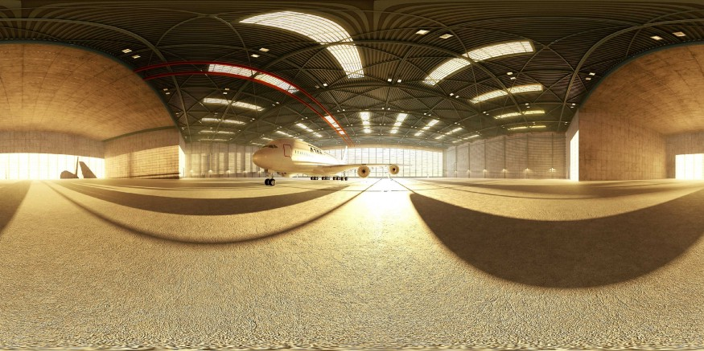
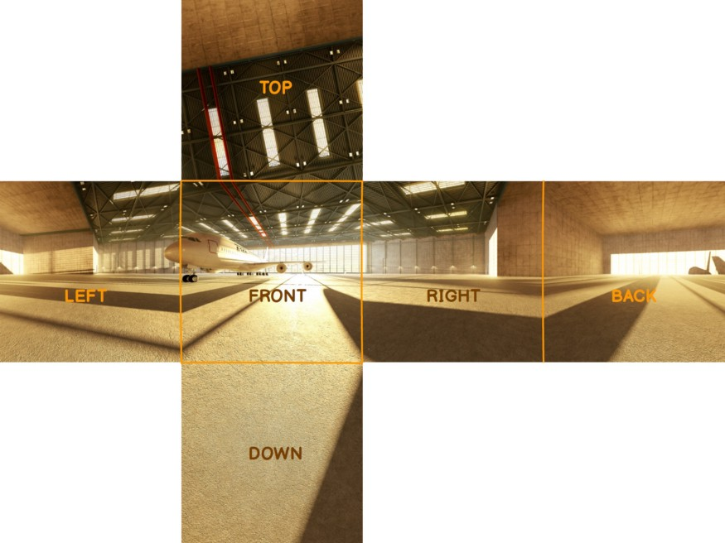
Abstract
Spatial Analysis | Image Encoding- 360° Equirectangular Panoramas to Cube Maps and vice versa
An equirectangular panorama consists of a single rectangular image whose width and height correlate as 2:1 as shown in the following figure.
The cubic format/ cube map uses six cube faces to fill the whole sphere around the viewer. These maps are often created by imaging the scene with six 90-degree field of view cameras giving a left, front, right, back, top, and bottom texture. The six images are typically arranged as an unfolded cube (‘horizontal cross’).

Slide 6
Theory
Equirectangular Panorama and Cubic Format
Panoramic projections are used to map a full or partial 3D scene onto a 2-dimensional surface. For example, cylindrical projections convey the scene visible in all directions, except for right above the viewer’s head and under their feet. This means that the top and bottom of the imaginary cylinder will be missing in such map images when they are ‘wrapped.’
Unlike cylindrical views, spherical panoramas incorporate a 180° vertical viewing angle and a 360° horizontal viewing angle. They contain light data originating from all directions, and therefore can be visualized as comprising the points on a sphere. This format has become popular in social media and marketing and has found application in 3D graphics programs, simulations of interiors, immersive panoramic movies, and computer and video games.

Slide 7
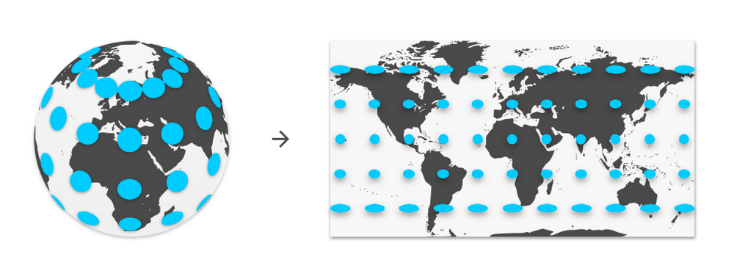
Equirectangular Projection
The most familiar representation is one where latitudes and longitudes are used to form a square grid.

Slide 8
Advantages
Both rectangular and straightforward, therefore it is much easy to visualize.
It’s also relatively easy to manipulate using existing video editing tools.
Disadvantages
The poles get a lot of pixels, and the equator gets relatively few. This is challenging, because spherical videos usually have their important content distributed around the equatorial regions (the middle), which is the viewer’s horizon.(data redundancy)
It has high distortion(near the poles), which makes existing video compression technology work harder.
Therefore coupling both, these shortcomings highlight the fundamental challenges of spherical video transmission.

Slide 9
Why do we need to convert from Equirectangular Format into the
Cube-map Format?
Equirectangular images are stretched in the ‘latitude’ direction. It is the reason for a considerable amount of data redundancy near the poles. When downsizing an image in an editor, the effective texture resolution is decreased as expected — except near the poles.
This can cause radial artifacts when viewed later in panorama viewers. (An equirectangular projection is thus suitable for simulating only those environments where the distortions of the texture at the top and bottom of the sphere are negligible.)
Converting an equirectangular image into a cube-map is most commonly used for some navigable virtual environment solutions or when editing the north and south poles of spherical panoramas.
The amount of distortion is higher, as a result of which the video compression process is difficult.

Slide 10
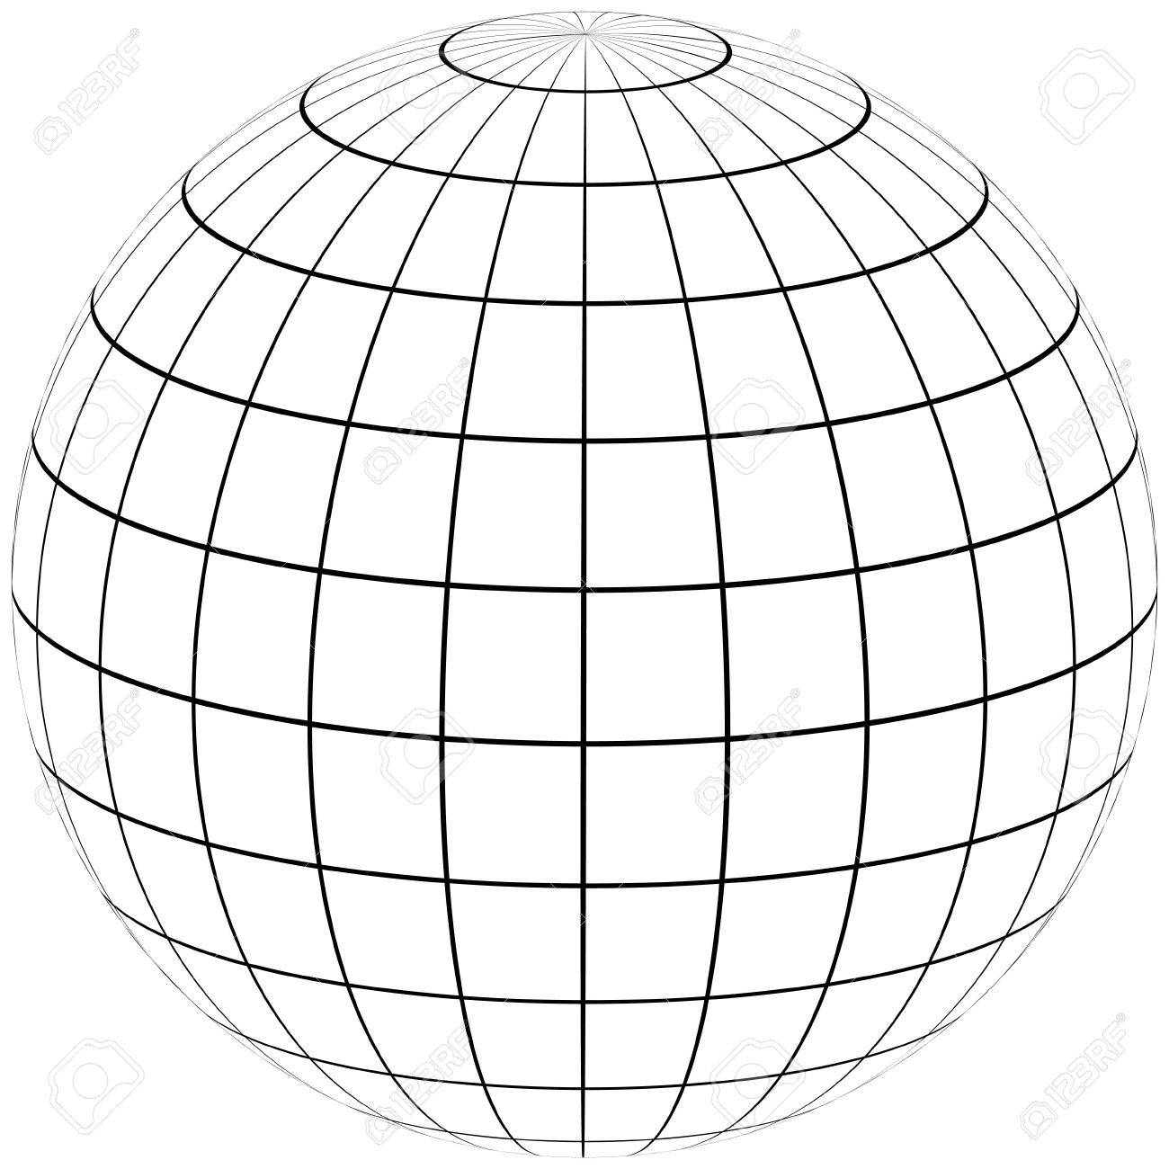
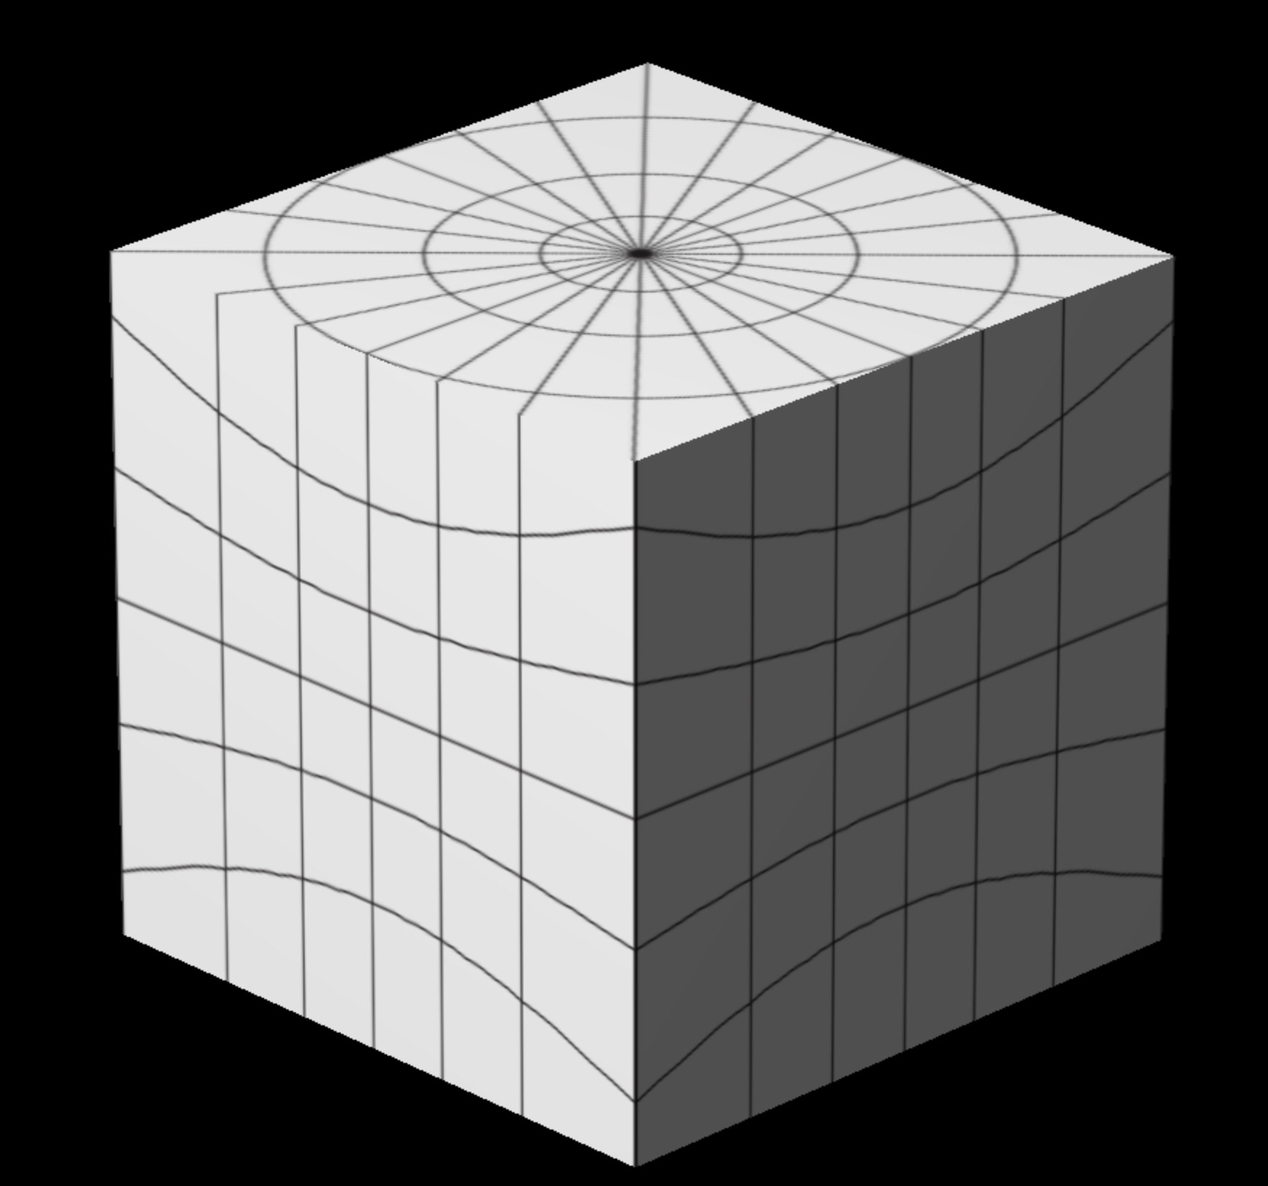
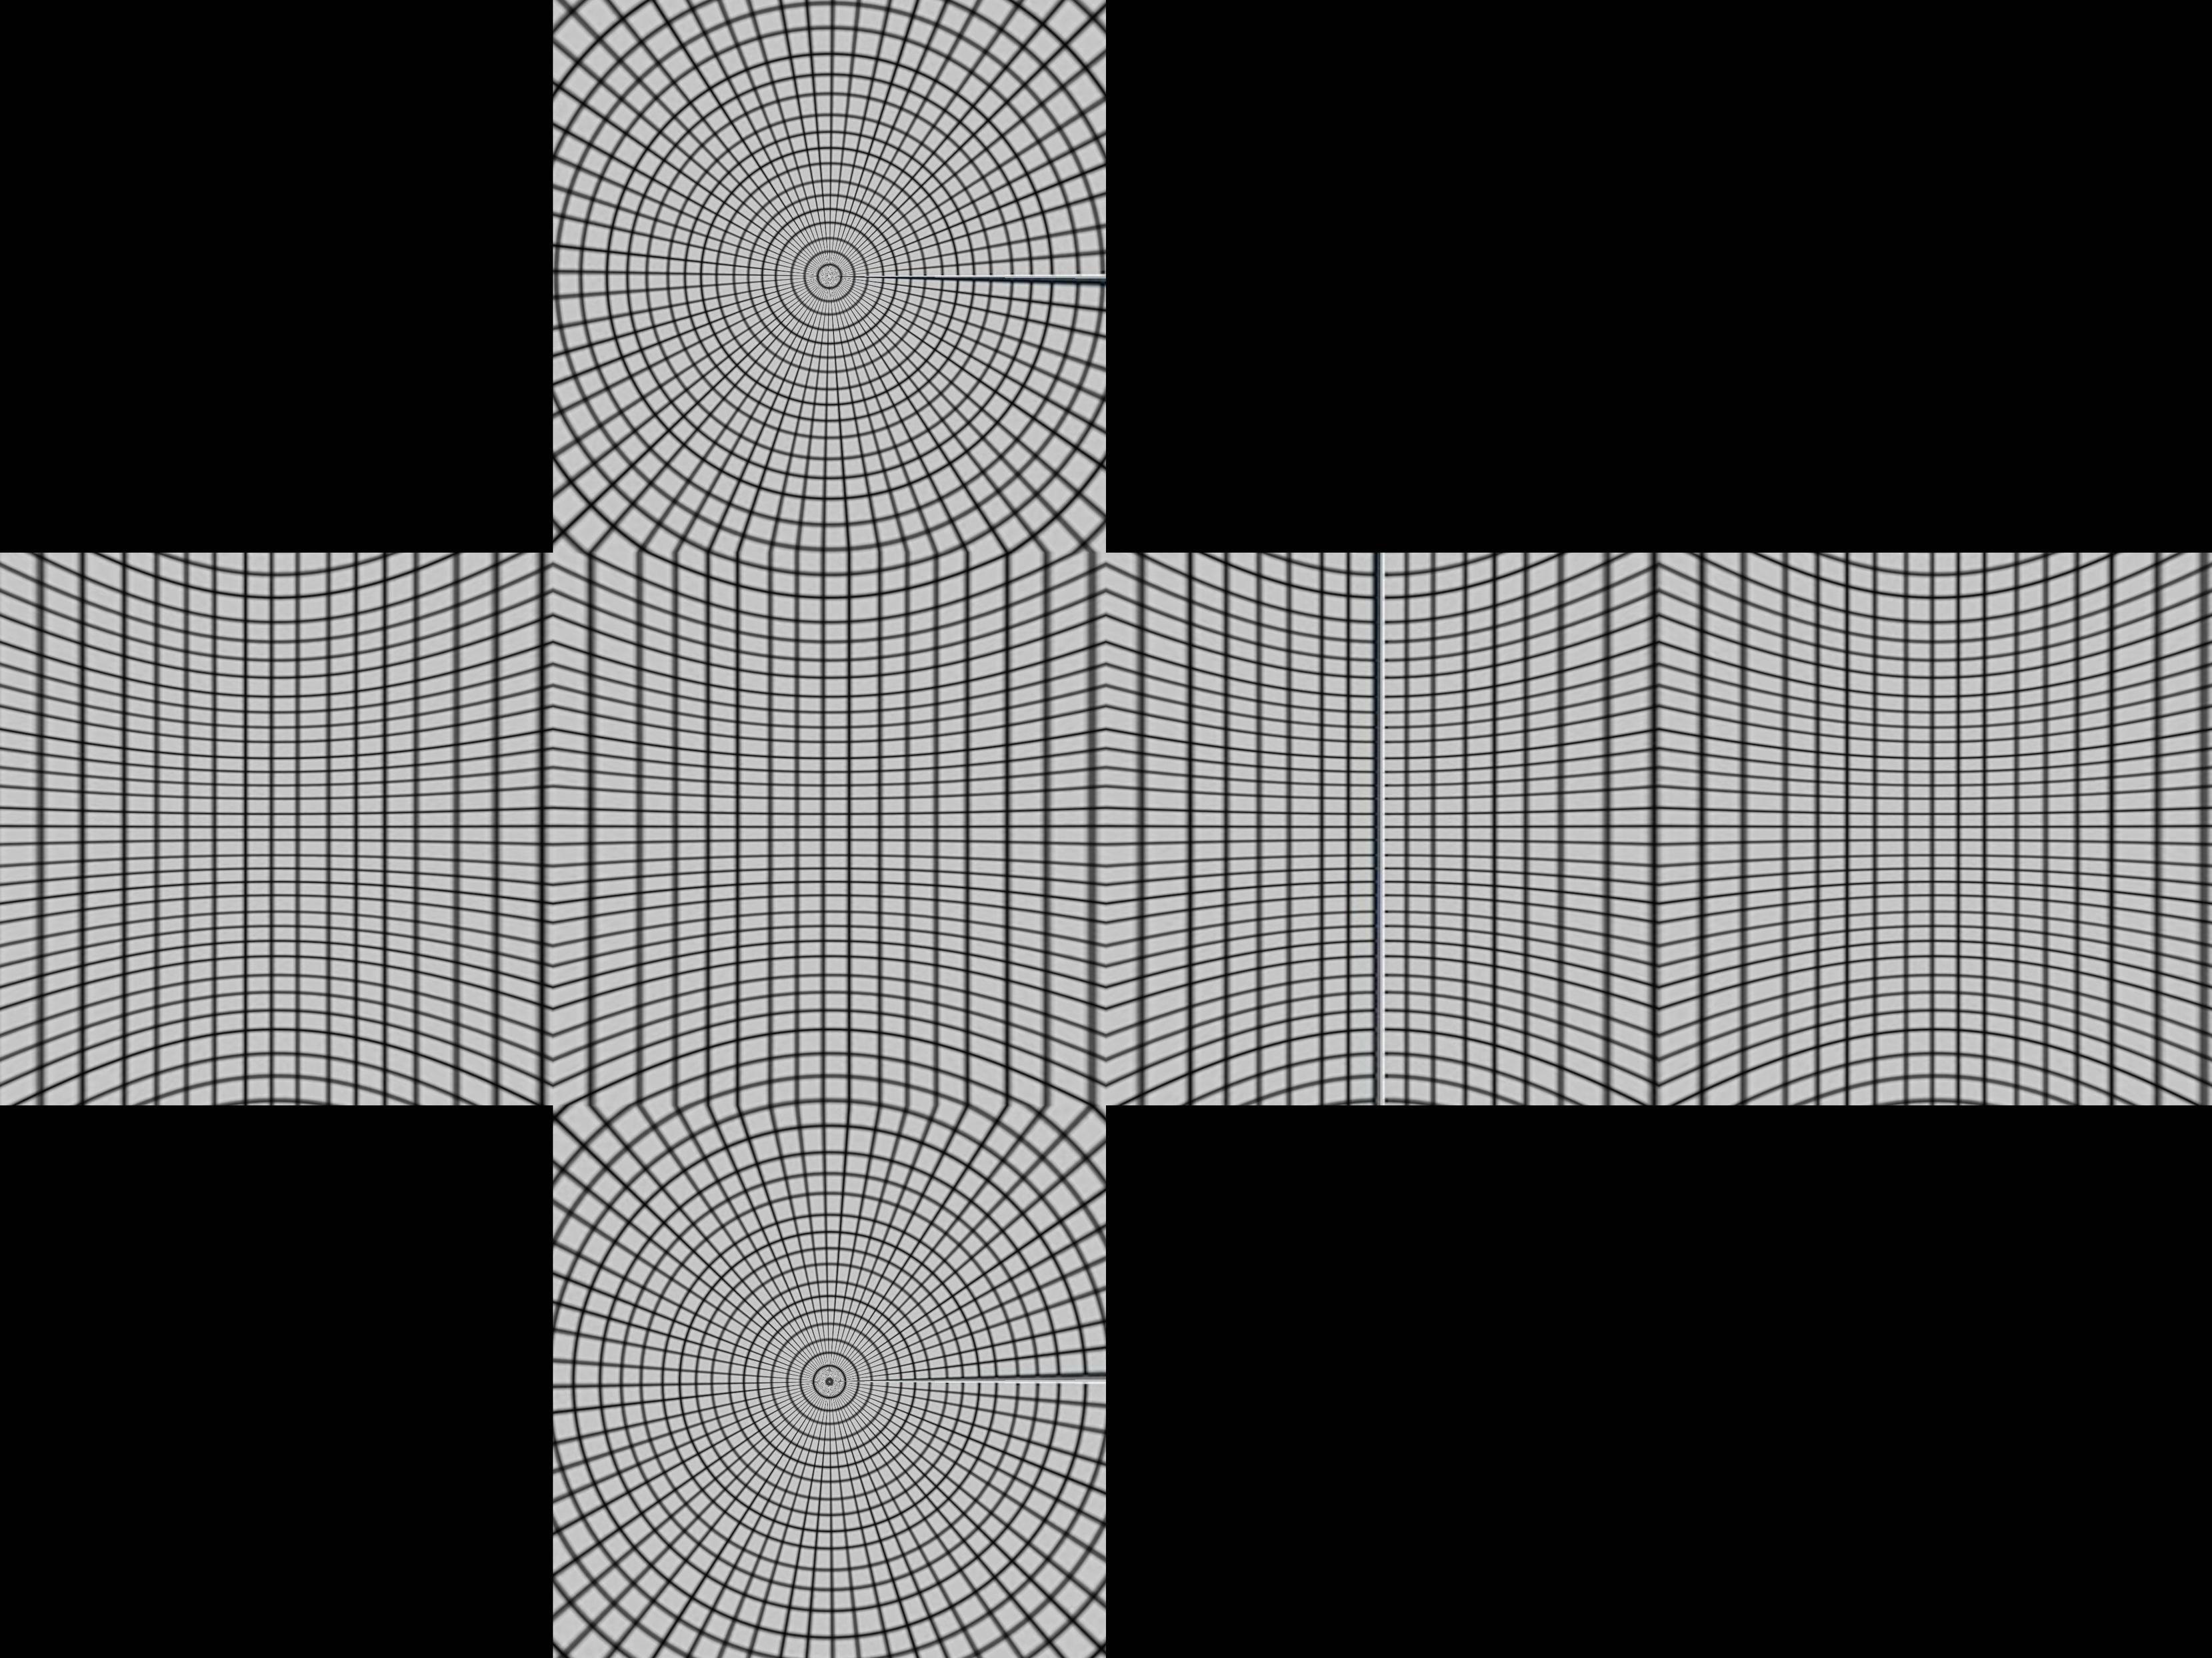
Cube-Map Projection
Concept: Deform a sphere into a cube, then unfold the cube’s six faces and lay them flat.

Slide 11
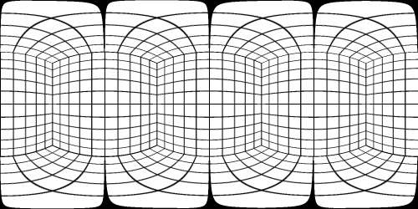
Attempt I
First, we divide into four regions by the latitude
where (0<ø<2π) and (–π/2<θ<π/2)
-π/4 < ø < π/4,
π/4 < ø < 3π/4,
3π/4 < ø < 5π/4,
5π/4 < ø < 7π/4.
where ø is the azimuthal angle and θ is the inclination angle, and this projects to the four sides of the cube.
Assume we are in the first side -π/4 < ø < π/4. The central projection of (sin(θ)cos(ø), sin(θ)sin(ø),cos(θ)) will be (asin(θ)cos(ø), asin(θ)sin(ø), acos(θ)) which hits the x=1 plane when a sin(θ)cos(ø) = 1.
The projected point on the cube can be can be given by -> (1, tan(ø), cot(θ)/cos(ø)){since a=1/ sinθcosø}.
If | cotθ/cosø | < 1 this will be on the front face. Otherwise, it will be projected on the top or bottom and you will need a different projection for that. A better test for the top uses the fact that the minimum value of cos ø will be cos π/4 = 1/√2, so the projected point is always on the top if cot θ /(1/√2)> 1 or tanθ < 1/√2. This works out as θ < 35º or 0.615 radians for the top surface.

Slide 12
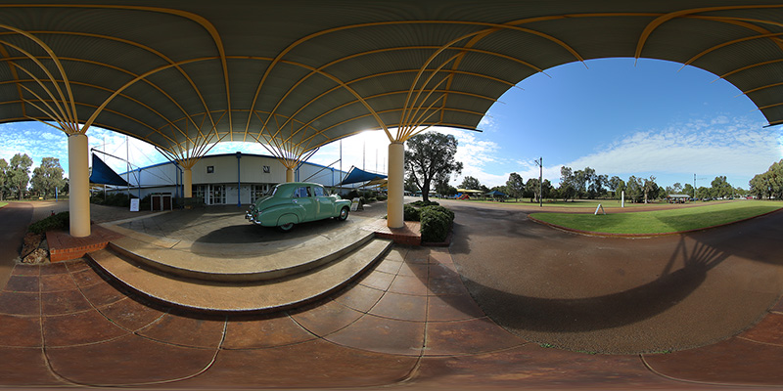
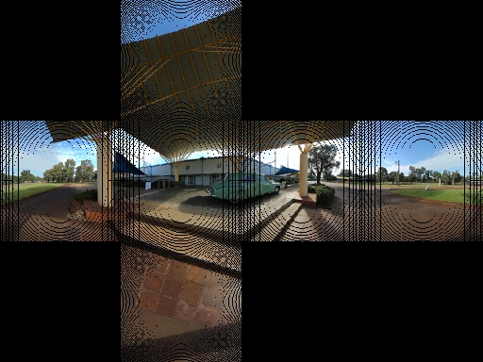
Result
In most cases, when an equirectangular projection is ’unwrapped’, the sphere has top and/or bottom artifacts. Even the increased number of polygons does not ensure proper quality.
(i)Input Image ii)Output Image(Image Artifacts)

Slide 13
Attempt-II
We are getting a few image artifacts. This is due to not having a 1 to 1 map of pixels. What we need to do is use an inverse transformation. Rather than loop through each pixel in the source and find the corresponding pixel in the target we loop through the target images and find the closest corresponding source pixel.
Algorithm
For each pixel in the output map work out what face this corresponds(X+,X-,Y+,Y-,Z+,Z-).
Get the current pixel coordinates relative to the individual face, not the entire cube map.
Normalize these coordinates, so they range between -0.5 and 0.5.
Fill in the missing part of the coordinate depending on what face you're currently completing within the cube map - giving us a complete 3D vector.
Use this 3D coordinate and convert to spherical coordinates.
Take the spherical coordinate and normalize θ and φ between 0 and 1.
Use this normalized coordinate and find the corresponding pixel in the input equirectangular image.
This process is repeated until we have made our way through all the pixels in the cube map.

Slide 14
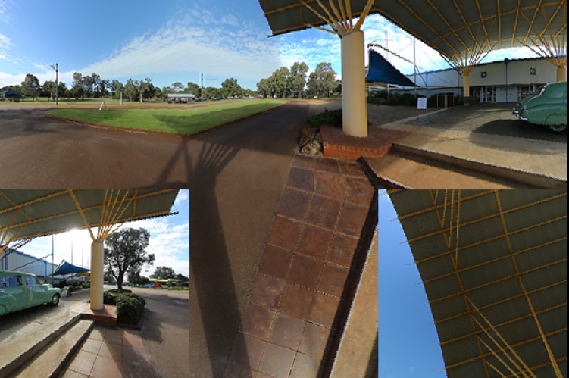
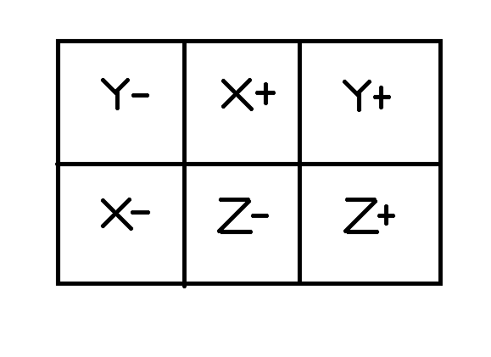
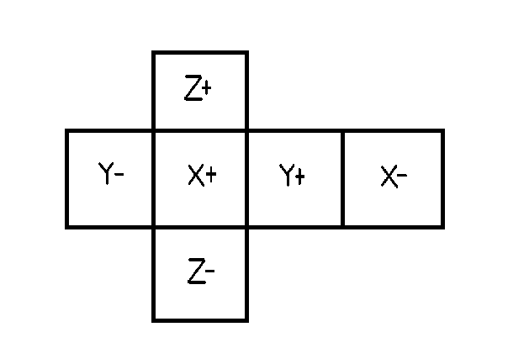
Attempt II- Result
The obtained image is based on the following format and when unfolded, obtain the crossed cubic form.

Slide 15
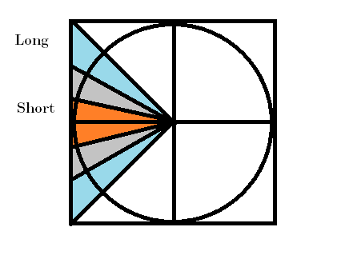
Shortcomings
In the figure below, the rays have all been equally spaced over the circle, but the points where the rays intersect the square are not equally spaced. As a result, the corners get more video pixels than the centers, because the longer blue line spans more pixels on the square edge than the red line, which again shortchanges the equator. In the full three-dimensional case, the effect is even more pronounced.
As seen from the figure, there still exists a small distortion along the edges, but when compared to the equirectangular projection these distortions are less pronounced.
Here the blue region shows an ideal distribution of pixels in the projection and the orange represents an insufficient density in the pixel distribution.

Slide 16
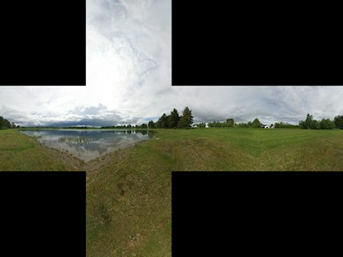
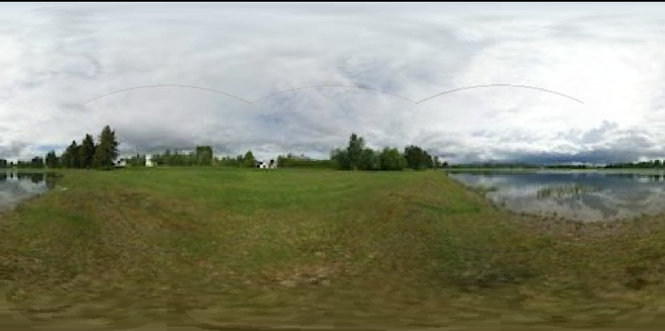
Cube-Map to Equirectangular Projection
The cube-map was also converted back to the equirectangular format to study the statistical analysis of the environment.
Inverse transformation was used to get near-accurate results(artifacts still occur).

Slide 17
Uniformity Comparisons
To visually compare different projection types is to use saturation maps. A saturation map shows a color-coded ratio of video pixel to display pixel density. The color coding goes from red to orange, yellow, green and finally blue.
- Perfect pixel density where the ratio is 1:1
- Insufficient density (too few video pixels for the available display pixels),
- Wasted resources (too many video pixels for the available display pixels).
The overall colors in a saturation map can be changed by increasing the resolution of the video. But for a saturation map with lots of variation, as you bring the least saturated areas to green, you also increase the area of the video where resources are being wasted. Therefore, the ideal projection has a saturation map that is uniform in color - because it can be uniformly green with sufficient resolution.
Saturation is highly dependent on the size of the image as well as the resolution of the output device. Different choices of resolutions will alter the overall greenness or orangness.

Slide 18
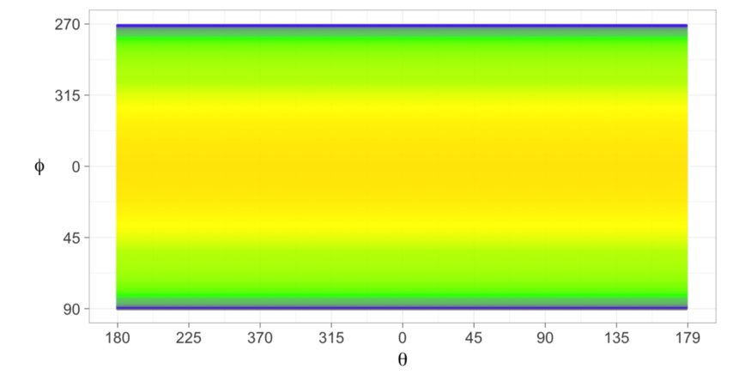
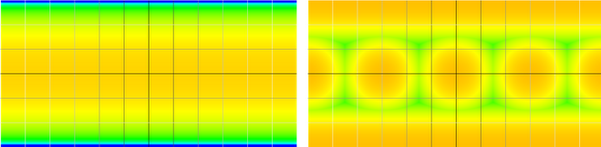
They also introduced a useful way to analyze the uniformity of this spacing by plotting saturation maps of the ratio of video pixel density to display pixel density for each direction the viewer is looking. We will call this the Pixel Density Ratio (PDR). So for a given set of yaw and pitch angles, (𝜃, 𝜙), we will denote the ratio of video pixels to display pixels in that direction as PDR(𝜃, 𝜙).
Quantifying viewer session quality
To create a good viewing experience, the video should display the optimal number of pixels in every direction the viewer looks. Another way of saying this is that the ratio PDR(𝜃i, 𝜙i) should be as close to 1 as possible for every sampled view direction (𝜃i, 𝜙i).
Saturation Map of PDR for (i)equirectangular projection (ii)cube-map projection

Slide 19
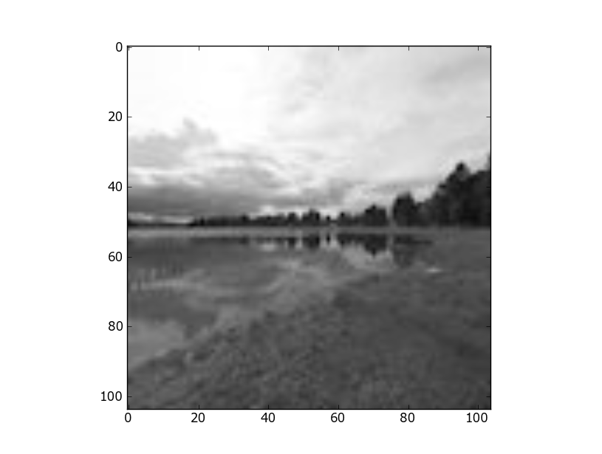
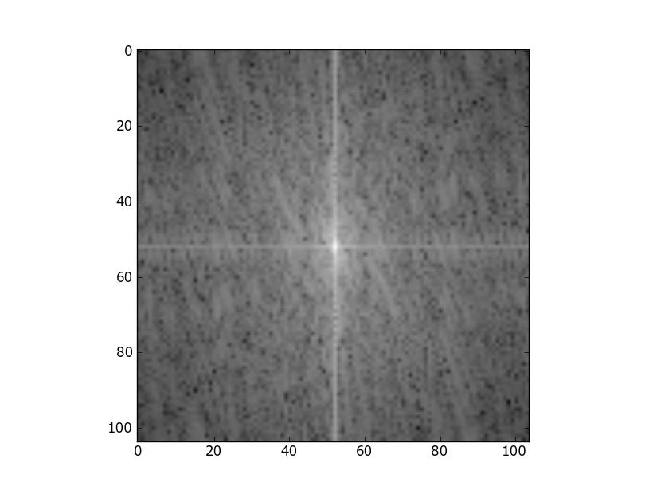
Frequency Analysis
Noise signals are introduced onto the faces of the cubemap and the variation of the pixel intensities are analysed.
(i) Face(X+) of the cube map (ii) Fourier Transform after (i)

Slide 20
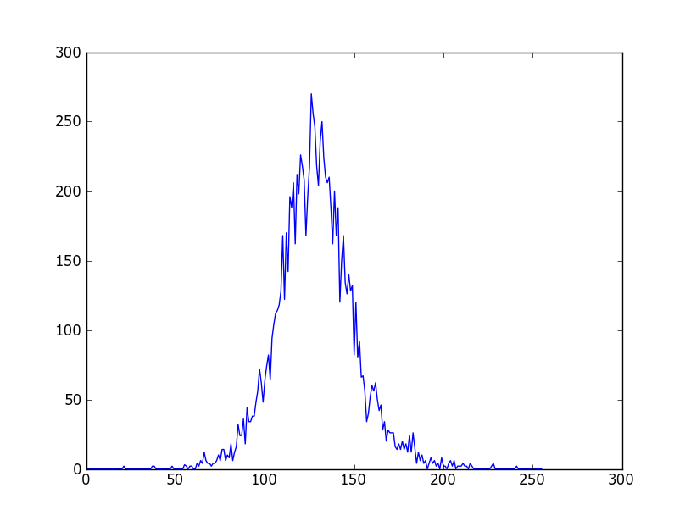
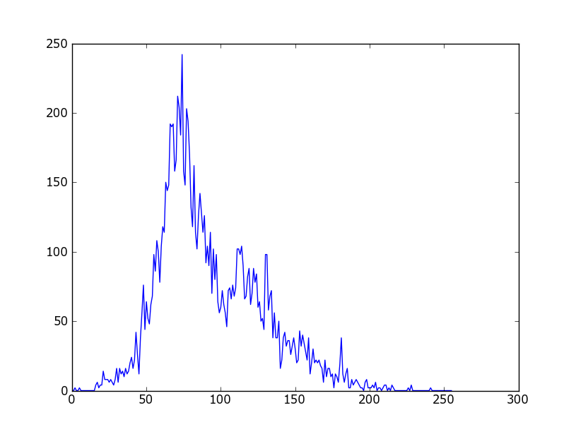
Histogram of the Images
Plotting the histogram after applying the Fourier Transform we obtain a Gaussian distribution (curve) for the same. Further on applying noise , we observe that the peak of the curve reduces and the curve gets stretched across the axis.
(iii) Histogram after ii. (iv) Histogram after the introduction of noise

Slide 21
Conclusion
Analyzed two projections of a virtual reality scene, Spherical and Cube-Map format and evaluated their differences.
Arrived at a solution to convert the equirectangular projection to the cube-map format , equivalently reducing the image artifacts occurring within the image and making best use of the network bandwidth available.
This way we can improve the quality of the image areas where we tend to look more.
Inverse transformation yielded better results than direct mapping because 1-1 mapping was ensured.
Saturation Maps-Another useful method to compare the two different projections visually can be employed to study the pixel variations in the formats.
Frequency Analysis- Noise signals (Gaussian Blur) was introduced to one of the faces of the cubic format and the respective histograms were plotted.

Slide 22
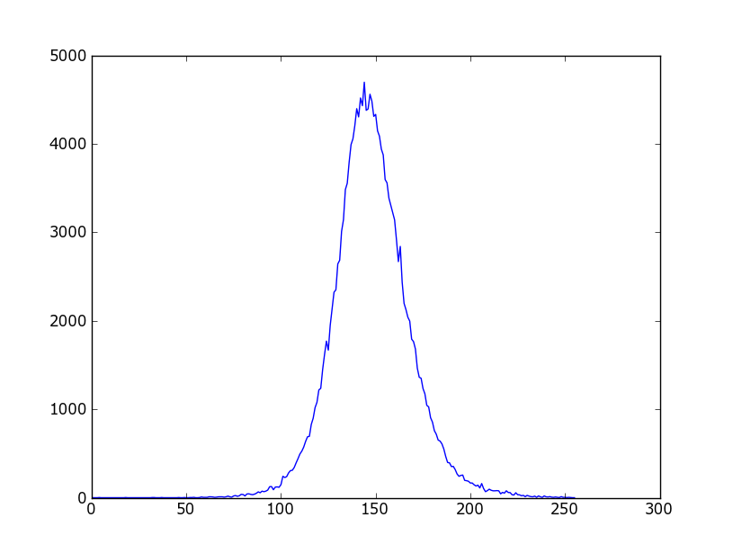
Additional Information
Plotting the histogram of the equirectangular image after the introduction of noise signals
The histogram obtained is a smooth Gaussian curve

Slide 23
References
Paul Bourke - http://paulbourke.net/miscellaneous/cubemaps/
Paul Reed-http://paul-reed.co.uk/programming.html
Google Blog- https://blog.google/products/google-ar-vr/bringing-pixels-front-and-center-vr-video/
Comparing 360° degree video formats-https://blog.vrtigo.io/comparing-360-video-formats-e82c83fd1ac7

